Slide 1
Chapter 18: Temp tables
2023

Slide 2
Chapter 18: Temp tables
Contents:
Introduction to temp tables
Local temp tables
global temp tables
Rank functions
Row functions
Positional functions
pivoting data (read)

Slide 3
Temp tables
Temporary tables are used to store data temporarily and they can perform CRUD (Create, Read, Update, and Delete), join, and some other operations like the persistent database tables.
Temporary tables are dropped when the session that creates the table has closed or can also be explicitly dropped by users. At the same time, temporary tables can act like physical tables in many ways, which gives us more flexibility. Such as, we can create constraints, indexes, or statistics in these tables.

Slide 4
SQL Server provides two types of temporary tables according to their scope:
1. Local Temporary Table - tables are visible for the duration of the connection and when the session is closed the local temporary table are dropped automatically
2. Global Temp Table - These tables can be accessed by all other sessions, unlike local ones.

Slide 5
Temp Tables
Local Temp Tables | Global Temp Tables
Created using the “CREATE TABLE” command. | Created using the “CREATE TABLE” command.
Created using a single hashtag (#). | Created using a double hashtags (##).
The table will be visible for the duration of the connection only. | The table will be visible in all sessions.
Example: CREATE TABLE #TempPersonTable ( PersonID int PRIMARY KEY IDENTITY(1,1), LastName varchar(255), FirstName varchar(255), City varchar(255)) | Example: CREATE TABLE ##Customers (CustomerId INT IDENTITY(1,1) PRIMARY KEY, CustomerFullName VARCHAR(50), EMail VARCHAR(50), CustomerAddress VARCHAR(50), Country VARCHAR(50))

Slide 6
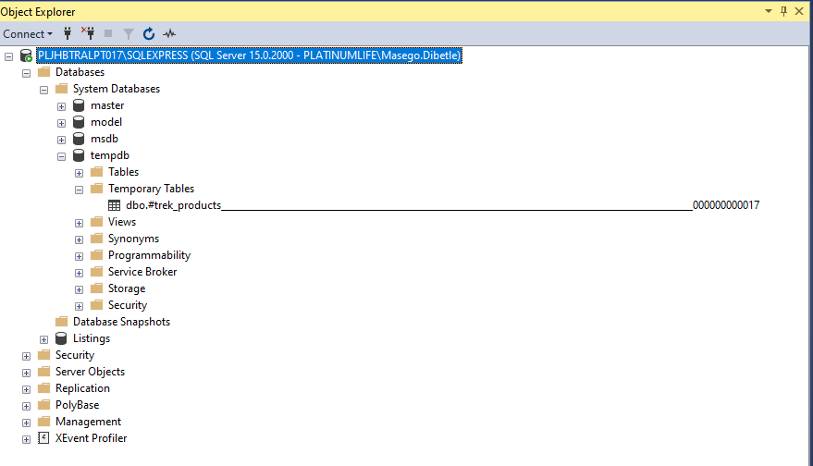
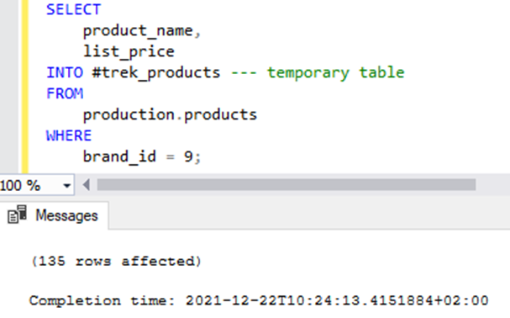
Temp tables
Notes:
An example where a table was used to add data to a temp table
*Note that the temp table is stored in the temp table folder on your database.

Slide 7

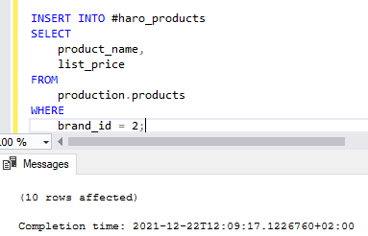
Temp tables
With this one you use the same syntax as creating a regular table. However, the name of the temporary table starts with a hash symbol (#) Like below image.
After creating the temporary table, you can insert data into this table as a regular table

Slide 8
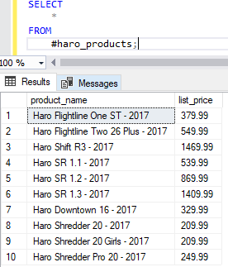
Temp tables
To confirm you can select from the temporary table created. However if you open another connection and try the query below, you will get an error: Invalid object name '#haro_products'.

Slide 9
Global Temp tables
Sometimes, you may want to create a temporary table that is accessible across connections. In this case, you can use global temporary tables.
Unlike a temporary table, the name of a global temporary table starts with a double hash symbol (##).
SQL Server drops a temporary table automatically when you close the connection that created it.
SQL Server drops a global temporary table once the connection that created it closed and the queries against this table from other connections completes
you can manually remove the temporary table by using the
“DROP TABLE ##table_name” statement

Slide 10
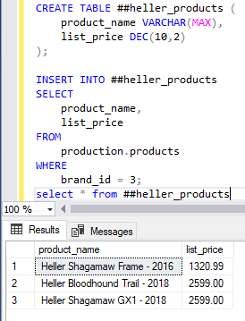

Slide 11
Difference between Temp tables and Materialized views
Temporary tables are:
tables that are created for temporary use within a specific session or transaction.
typically used to store intermediate results of complex queries or to stage data for processing.
stored in the tempdb database, which is a system database that is used to store temporary objects.
Materialized views:
database objects that contain precomputed results of a query.
stored in the same way as regular tables and can be indexed and optimized for query performance.
typically used for frequently executed queries that involve complex joins or aggregations.

Slide 12
Temp tables
Create a database called ‘Disney’.
Create a local temp table called characters, with the following columns and data: name, city and scene.
Create a global temp table called CharNames from the characters table using on Names column.
Disconnect the session from your server and reconnect which tables were dropped, Why?
Delete the CharNames table from the DB.
name | city | scene
Goofy | France | 301
Minnie Mouse | Italy | 304
Simba | Texas | 400
Disney
Notes:
Answer
SELECT
product_id
product_name
brand_id
list_price
RANK () OVER (
PARTITION BY brand_id
ORDER BY list_price DESC
) price_rank
FROM
production.products
) t
WHERE price_rank <= 3;

Slide 13
Rank Functions
The RANK () function is a window function that assigns a rank to each row in the result set partition.
Rows in partitions with the same value are given the same rank.
The rank of the first row in the partition is 1.
The RANK () function adds the number of rows in a tie to the rank of the tie and calculates the rank of the next row so the ranks may not be contiguous.

Slide 14
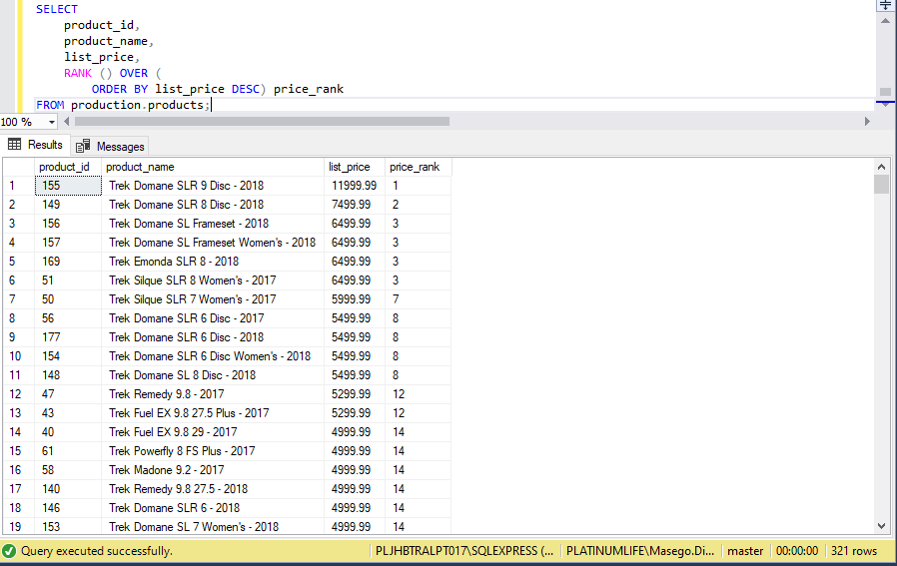

Slide 15
Rank function
Use the RANK() function to write a query that assigns a rank to each listing by the price, assuming that the biggest price has the rank 1, ensure that your query displays the name of the listing the room type your prize and your final column which is your ranking.

Slide 16
Row number Function
ROW_NUMBER function is similar to the Rank function except that it numbers all rows sequentially (for example 1, 2, 3, 4, 5). RANK provides the same numeric value for ties (for example 1, 2, 2, 4, 5).
SYNTAX: ROW_NUMBER ( ) OVER ( [ PARTITION BY value_expression , ... [ n ] ] order_by_clause )

Slide 17
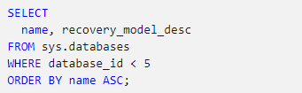
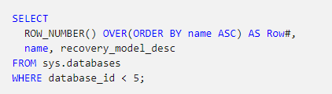
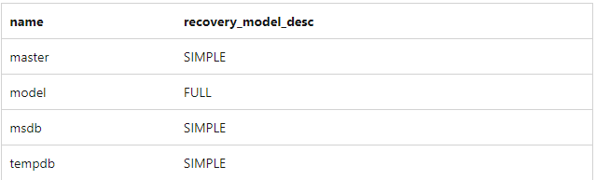
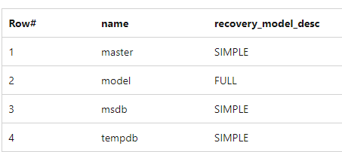
Row number Function
A table query before the row function
A table query applying the row function

Slide 18
positional functions
These are window functions and are very useful in creating reports, because they can refer to data from rows above or below the current row. The LAG() and LEAD() are positional functions which we will cover.
The LAG() function
The LAG() function allows access to a value stored in a different row above the current row. The row above may be adjacent, or some number of rows above, as sorted by a specified column or set of columns.
The LEAD() function
LEAD() is similar to LAG(). Whereas LAG() accesses a value stored in a row above, LEAD() accesses a value stored in a row below.

Slide 19
The LAG() function
SYNTAX:
LAG(expression [,offset[,default_value]]) OVER(ORDER BY columns)
This function takes three arguments: the name of the column or an expression from which the value is obtained, the number of rows to skip (offset) above, and the default value to be returned if the stored value obtained from the row above is empty. Only the first argument is required. The third argument (default value) is allowed only if you specify the second argument, the offset.

Slide 20
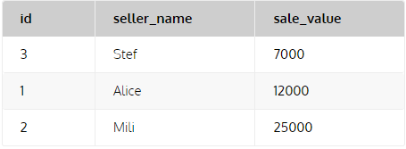
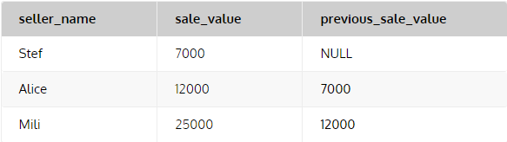

The LAG() function
Lets consider the table below
The output/Result:

Slide 21
The LEAD() function
SYNTAX: LEAD(expression [,offset[,default_value]]) OVER(ORDER BY columns)
LEAD() is like LAG(). Whereas LAG() accesses a value stored in a row above, LEAD() accesses a value stored in a row below. the LEAD() function takes three arguments: the name of a column or an expression, the offset to be skipped below, and the default value to be returned if the stored value obtained from the row below is empty. Only the first argument is required. The third argument, the default value, can be specified only if you specify the second argument, the offset.

Slide 22
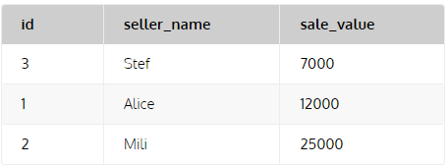
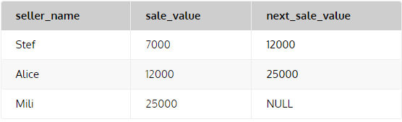

The LEAD() function
Lets consider the table below
The output/Result:

Slide 23
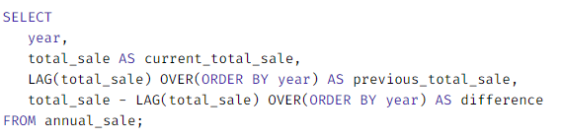
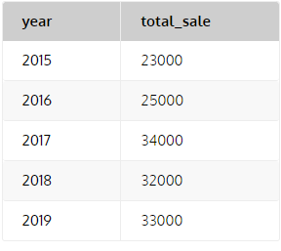
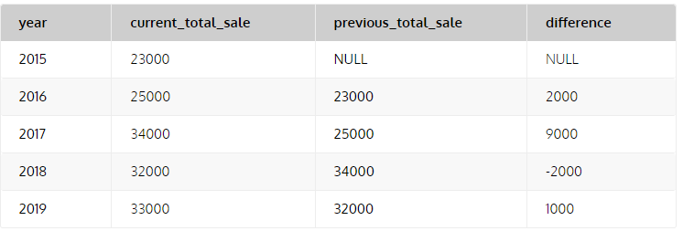
Comparing Data using Positional functions
Lets consider the sales table
As you can see, this table contains the total sale amount by year. Using LAG() and LEAD(), we can compare annual sale amounts across years.

Slide 24
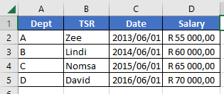
Positional functions
Create the following table and add the data as above
Each year the TSR is moved to the next department Use the suitable functions on the date column to estimate a calculated departure date of the TSR and their new salaries, ensure your query returns the name, original date of the employment and your new columns, give them suitable names.
Use the suitable function on the department field to know which department the TSR is from, ensure your query returns the name of the TSR, their current department and a new department column, give it a suitable name.
Compose all the data from the above queries into one output: name of TSR, their current department, date of hire and your new two columns from above.
AirBnB
Notes:
Answer
SELECT
product_id
product_name
brand_id
list_price
RANK () OVER (
PARTITION BY brand_id
ORDER BY list_price DESC
) price_rank
FROM
production.products
) t
WHERE price_rank <= 3;

Slide 25
Pivoting data
Data pivoting enables you to rearrange the columns and rows in a report so you can view data from different perspectives.
With data pivoting, you can do the following:
Move an object (a business attribute or a metric calculation) and its related data from a row to a column.
Move an object (a business attribute or a metric calculation) and its related data from a column to a row.
Change the order of objects in the rows.
Change the order of objects in the columns.

Slide 26
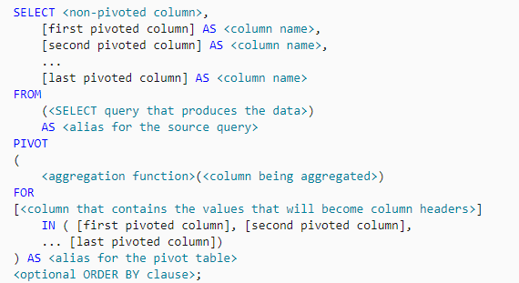
Pivoting data
This is the setup for a sample for pivoting data
Notes:
Advanced
tsql?

Slide 27
Pivoting data
PIVOT relational operators convert data from row level to column level.
PIVOT rotates an expression in a table value by converting a unique value from one column of the expression to multiple columns of output.
You can use the PIVOT operator to perform aggregate operations wherever you need them.
Notes:
Advanced

Slide 28
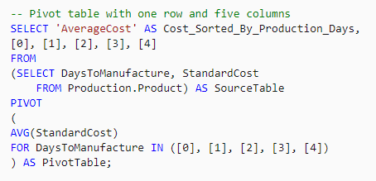

Example
DaysToManufacture | StandardCost
0 | 3.7
1 | 238
0 | 7.8
1 | 203.5
2 | 255.6
4 | 1508
2 | 224.9
4 | 1007
3 | Null
4 | 1678
4 | 53

Slide 29
Pivoting data
create a summary report to determine the total amount made from the private rooms, hotel rooms and shared rooms. Your summary should include the neighbourhood.
AirBnB
Notes:
select *
from (select neighbourhood,price,room_type from listings) As tb
pivot(sum(price) for room_type in( [Private room],[hotel room],[shared room]))
As pivot_table

